Slide 1
Wow Technical Deliverable
RDIOP-300:Setup monitoring per YARN queue
6th Aug’ 2019

Slide 2
Problem Statement
As a user, I would like to have monitoring of allocated cores/memory per YARN queue monitored and included as time series in the monthly operations report.
Ref for the ticket: https://wcdma-jira.rnd.ki.sw.ericsson.se/browse/RDIOP-300
"Post implementing YARN queue end user demanded monitoring solution for Queue monitoring. They have asked for metrics collection in terms of time series DB"

Slide 3
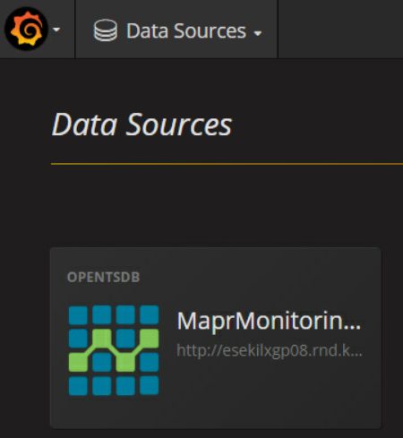
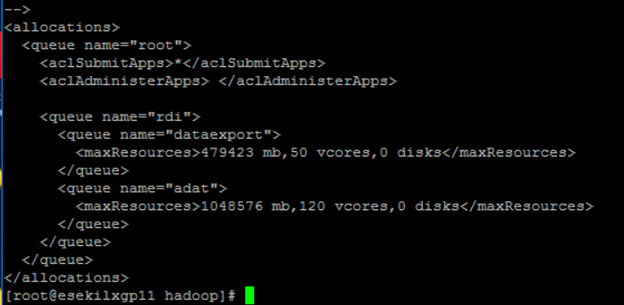
Solution Delivered/Implemented
Technical Details of the Solution:-
Prerequisites :
Grafana , Collectd , OpenTSDP (GCO) must be installed and configured.
Total GCO stack must be up and running .
OpenTSDB must be added as a source into the grafana
Yarn queue set up must be implemented in fair-scheduler.xml.
Fair-scheduler.xml

Slide 4
Implementation steps:
Configure collectd to populate the queue parameters
To configure collectd to create queue filters for mapr.rm.* metrics, define each queue that you want to create filters for in the. Copy all the parameters under the tag < MBean "QueueMetrics"> like below
Go to /opt/mapr/collectd/collectd-<version>/etc/collectd.conf
<MBean "QueueMetrics">
ObjectName "Hadoop:service=ResourceManager,name=QueueMetrics,q0=root"
InstancePrefix "rm“
.
.
.
</MBean>
For Sub-Queues we have to change the tag as
q0=root, q1 = subqueue1 or
q0=root, q1 = subqueue1 , q2 = sub-subque1 etc.

Slide 5
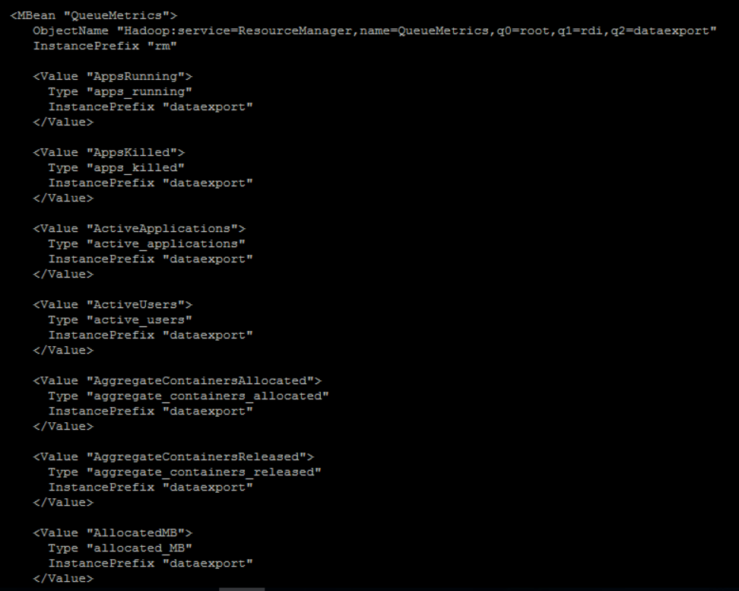
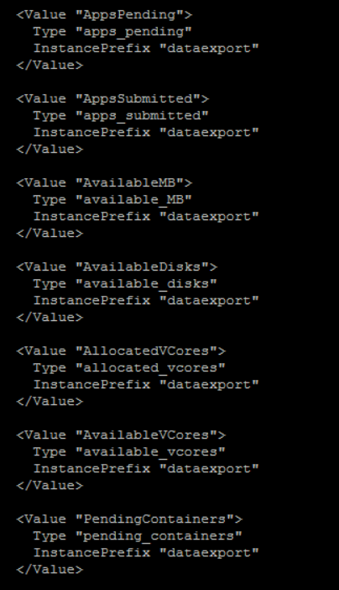
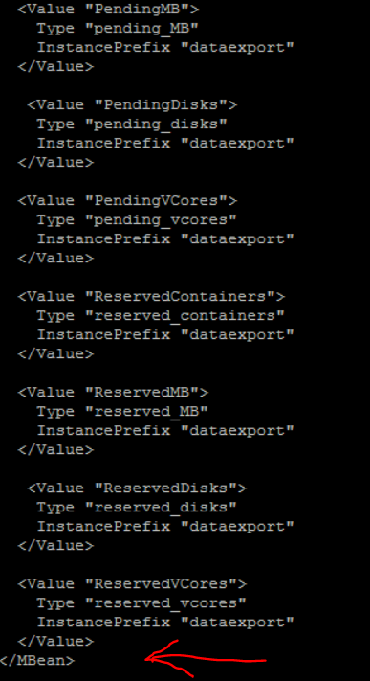
collectd.conf

Slide 6
Grafana Dash board links
Grafana dash board for yarn queue :
https://esekilxgp11.rnd.ki.sw.ericsson.se:3000/dashboard/db/yarn-queue?orgId=1
Grafana dash board for yarn sub queue monitoring :
https://esekilxgp11.rnd.ki.sw.ericsson.se:3000/dashboard/db/yarn-sub-queue?orgId=1

Slide 7
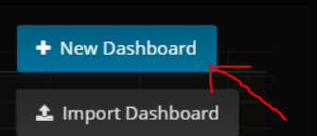
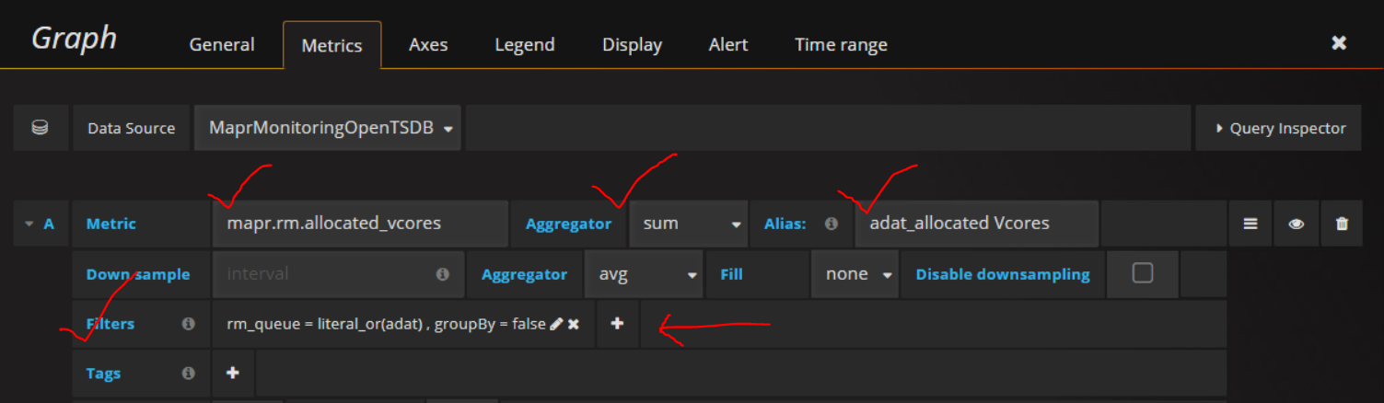
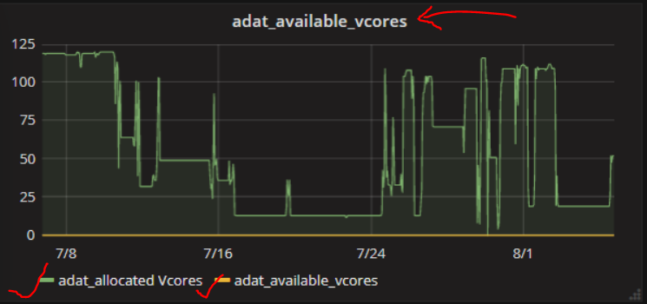
Queue set up in Grafana dash board
Create new dash board
Select the metric, aggregator , alias as shown
Add the queue name in the filter as shown
Save your changes into the dash board
Metrics can be monitored by the dashboard now

Slide 8
Advantages
Post implementing DA there were various jobs which were not getting adequate resources. With this solution implemented ,we can monitor the the vcores and memory consumed by the jobs.
YARN queue monitoring helps graphical visualization of the resources per queue e.g. CPU/Vcores/Memory etc
It act as a graphical monitoring tool to tune the jobs/cluster resources for effective use.
Rather than reading YARN Logs or RM logs or Spark History Server logs this can be easily understood by Application Developers as well.
It has been integrated with Grafana, which is our central monitoring tool , so, it unifies the monitoring.
The same process can be used for Historical Analysis using OpenTSDB Data which is a Time Series DB.

